Slide 1

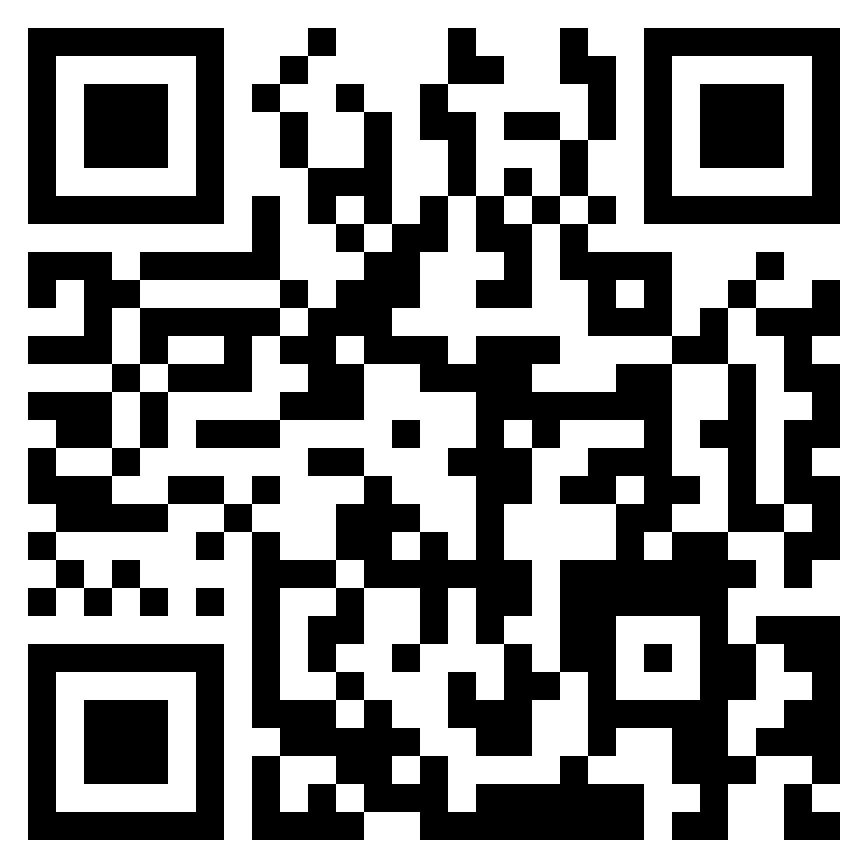



Welcome to the {iddoverse}: An R package for Converting IDDO-SDTM Data to Analysis Datasets
Rhys Peploe^{1,2}, Kasia Stepniewska^{1,2}, James Watson^{1,2,3} and Prabin Dahal^{1,2}
¹ Infectious Disease Data Observatory, University of Oxford, UK; ² Centre for Tropical Medicine and Global Health, Nuffield Department of Medicine, University of Oxford, Oxford, UK; ³ Oxford University Clinical Research Unit, Ho Chi Minh City, Viet Nam
Background
Objective
Process for PREP functions
Study Data Tabulation Model (SDTM) provides a coherent frameworks for the storage and pooling of studies and clinical trials.
Using SDTM for heterogeneous historical studies requires customisation in the implementation of the standard at IDDO.
However, the SDTM format is not as accessible for researchers in Low- and Middle-Income Countries (LMICs) due to education, time and resource limitations.
Creation of an open-source package to assist in the conversion of SDTM data to analysis datasets, using IDDO implementation.
This reduces the amount of duplicated work and prompts reproducible outputs.
The effectiveness of packages like {admiral} (part of the Pharmaverse) are limited since our implementation is not compatible, and our audience are not regular SDTM users.
Provide additional features to improve data use, such as recalculating Body Mass Index results and including Child Growth Standards into outputs
PREP_DM, PREP_LB_BL, PREP_VS_FU are examples of functions in the package.
For each domain, they convert blanks to NA and results to upper case and character class
Amalgamate data using standardised results or decoded terms, and where NAs exist fill with modified or original results
Filter to variables of interest, which users can specify and add to using the VARS parameter, other filters may also be applied (domain dependent)
Pivot the domain wider so the terms or tests are now columns
Package
Take a Laboratory (LB) domain, curated into our implementation of SDTM, subset to include essential information.
To become adept with CDISC standards, you need to commit time into learning the variable names and descriptions. Researchers may not realised the difference between VISITDY and LBDY, or LBSTRESN and LBORRES.
USUBJID | LBTESTCD | LBORRES | LBORRESU | LBSTRESC | LBSTRESN | LBSTRESU | VISITNUM | VISITDY | LBDY | EPOCH
RPTESTB_001 | HGB | 95 | g/L | NA | 95 | g/L | 1 | 1 | 1 | BASELINE
RPTESTB_001 | PLAT | 181000 | 10^6/L | NA | 181 | 10^9/L | 1 | 1 | 1 | BASELINE
RPTESTB_001 | HGB | 88 | g/L | NA | 88 | g/L | 2 | 3 | 3 | TREATMENT
RPTESTB_002 | HGB | 101 | g/L | NA | 101 | g/L | 1 | 1 | 2 | BASELINE
RPTESTB_002 | PLAT | 100000 | 10^6/L | NA |  |  | 1 | 1 | 2 | BASELINE
RPTESTB_002 | HGB | 99 | g/L | NA | 99 | g/L | 2 | 3 | 4 | TREATMENT
When receiving data stored by IDDO, investigators transform the SDTM data into an analysis dataset, as a result, the generated dataset is inconsistent and often cumbersome to reproduce, this process is heavily dependant on their coding ability and CDISC knowledge.
Using the {iddoverse} package, users can utilise functions which transform domains with minimal input. They retain the flexibility to add variables and choose different options, so they still have control over the output.
Below is the transformed, truncated, dataset. Data has been condensed into one row per person, per day, providing a clearer and easier to analyse data frame. This output can be achieved by executing one command in R.
USUBJID | AGE | SEX | ARMCD | VISITNUM | VISITDY | DAY | HGB | HGB_UNITS | PLAT | PLAT_UNITS | HEIGHT | HEIGHT_UNITS | WEIGHT | WEIGHT_UNITS
RPTESTB_001 | 67 | F | PBO | 1 | 1 | 1 | 95 | g/L | 1 | 10^9/L | 167 | cm | NA | NA
RPTESTB_001 | 67 | F | PBO | 2 | 3 | 3 | 181 | 10^9/L | NA | NA | NA | NA | 60 | kg
RPTESTB_002 | 18 | F | TRT | 1 | 2 | 2 | 101 | g/L | 100000 | 10^6/L | 143 | cm | NA | NA
RPTESTB_002 | 18 | F | TRT | 2 | 4 | 4 | 100000 | 10^6/L | NA | NA | NA | NA | 42 | kg
By not conforming to CDISC Analysis Data Model (ADaM) terminology, the columns are more understandable to a wider audience.
Conclusion & Future Work
Generation of standardised analysis dataset, using custom SDTM implementation is possible, demonstrating promising ability to speed up exploratory data analysis and makes the SDTM format more accessible to researchers unfamiliar with the format.
Consequently, if the data in the IDDO repository is more digestible, people will be more confident requesting data and delivering high quality research in the infectious disease community
Number of functions, diseases and domains in the package will be expanded, as well as, introducing additional features that investigators and subject matter experts suggest.
Time complexity is an area for improvement, the package performs well for under 50,000 subjects, but struggles at larger quantities.
Check out our GitHub repository for the {iddoverse}
iddo.org
@IDDOnews
info@iddo.org
Presented at CDISC + TMF Europe Interchange, Berlin, Germany, April 24th & 25th 2024

